Slide 1
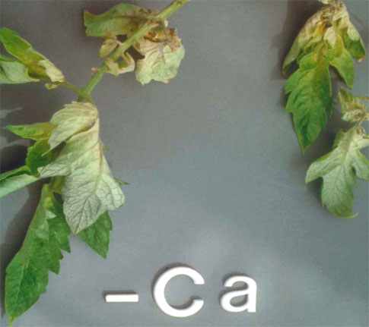
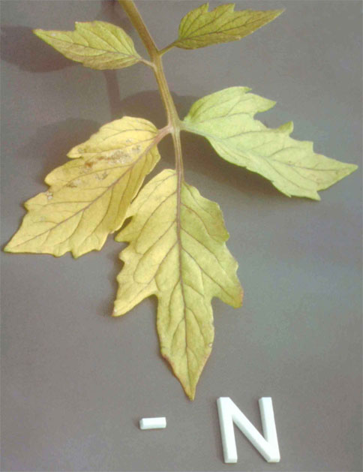
4.0 MINERAL NUTRITION
4.4 Symptoms of Mineral Deficiency - Macronutrients
Calcium (Ca)
  New leaves are distorted or hook shaped.
  The growing tip may die.
  Contributes to blossom end rot in tomatoes, tip burn of cabbage.
Nitrogen (N)
  Older leaves, generally at the bottom of the plant, will yellow.
  Remaining foliage is often light green.
  Stems may also yellow and may become spindly. Stunted growth.

Slide 2
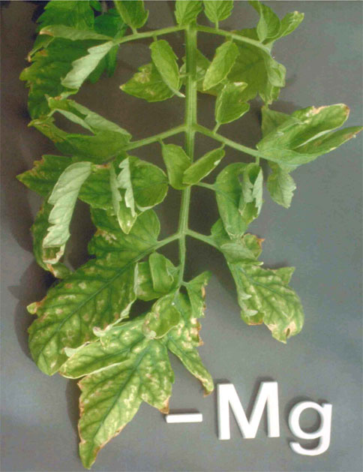
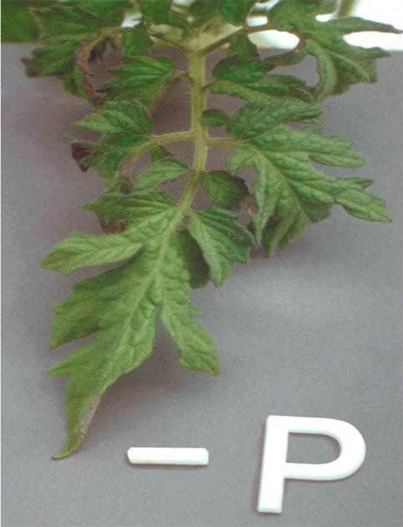
4.0 MINERAL NUTRITION
4.4 Symptoms of Mineral Deficiency - Macronutrients
Magnesium (Mg)
  Slow growth and leaves turn pale yellow, sometimes just on the outer edges.
  Mottled chlorosis with veins green and leaf tissues yellow or white. Necrotic spots may develop.
Phosphorus (P)
Small leaves that may take on a reddish-purple tint.
Leaf tips can look burnt and older leaves become almost black.
Reduced fruit or seed production.

Slide 3
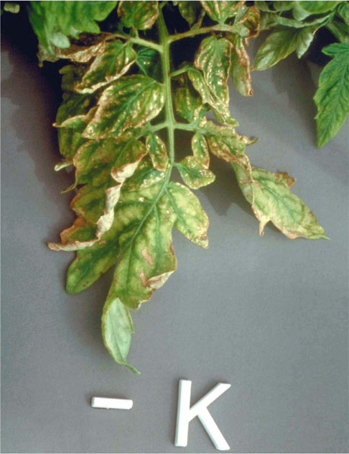
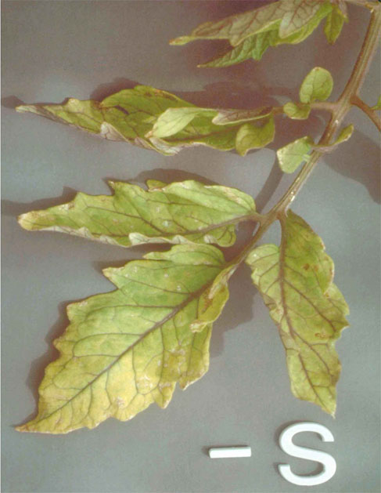
4.0 MINERAL NUTRITION
4.4 Symptoms of Mineral Deficiency - Macronutrients
Potassium (K)
Older leaves may look scorched around the edges and/or wilted.
Interveinal chlorosis (yellowing between the leaf veins) develops.
Stunted growth, little/no flowering.
Sulphur (S)
New growth turns pale yellow, with red or purple pigmentation, older growth stays green.
Stunted growth, marked decrease in leaf size. Fruit formation suppressed.

Slide 4
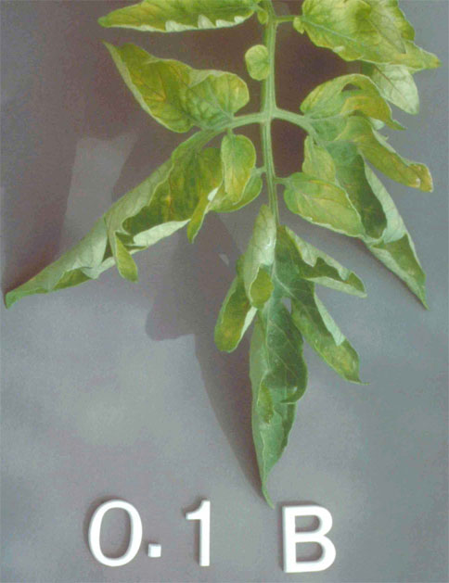
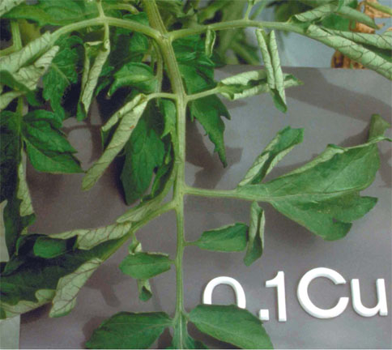
4.0 MINERAL NUTRITION
4.4 Symptoms of Mineral Deficiency - Micronutrients
Boron (B)
Dwarf plant, poor stem and root growth.
Leaves become twisted and necrotic.
Stalk finally die from terminal bud end.
Copper (Cu)
Stunted growth, leaves can become limp, curl, or drop (permanently wilted) without spotting.
Seed stalks also become limp and bend over (unable to stand erect).

Slide 5
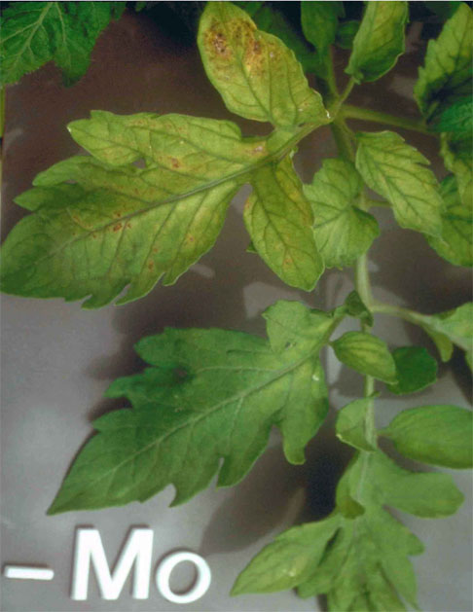
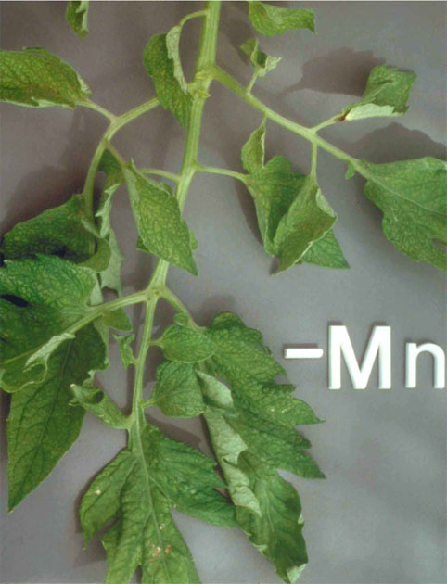
4.0 MINERAL NUTRITION
4.4 Symptoms of Mineral Deficiency - Micronutrients
Manganese (Mn)
Chlorosis of young leaves with spots of dead tissues scattered over leaf.
Leaves take on a gray sheen, develop dark freckled and necrotic spots along veins with increased deficiency.
Leaves, shoots and fruit diminished in size. Failure to bloom.
Molybdenum (Mo)
Older leaves mottled yellow, remaining foliage turns light green.
Leaves can become narrow and distorted.

Slide 6
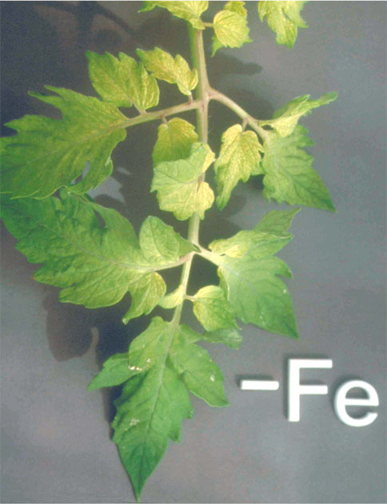
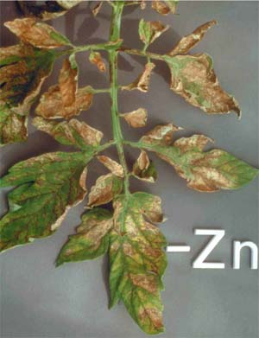
4.0 MINERAL NUTRITION
4.4 Symptoms of Mineral Deficiency - Micronutrients
Zinc (Zn)
Necrotic spots large and spreading to veins.
Leaves become leathery, margins twisted.
Terminal (end) leaves may form a rosette.
Iron (Fe)
Leaves show strong chlorosis at the base with some green netting.
Interveinal chlorosis of the youngest leaves, bleached leaf.

Slide 7
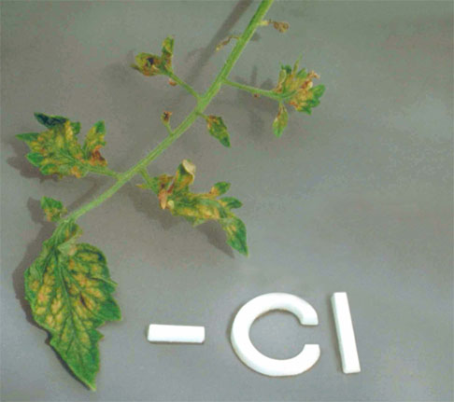
4.0 MINERAL NUTRITION
4.4 Symptoms of Mineral Deficiency - Micronutrients
Chloride (Cl)
Leaves have abnormal shapes, with distinct interveinal chlorosis and wilting of the young leaves.

